Slide 1
Chapter 2
Variables and Simple Data Types

Slide 2

Goals
1. Learn about different types of data
2. Learn how to store your data in variables
3. Learn how to use variables

Slide 3
Variables
Let’s try a variable called ”message”.
message = "Hello Python world!"
print(message)
message = "Hello Python Crash Course world!"
print(message)
Hello Python world! Hello Python Crash Course world!

Slide 4
Naming and Using Variables
Notice:
Use only letters, numbers, and underscores. You can’t name a variable starting with numbers.
No spaces.
Avoid using Python keywords and function names already used in Python (e.g. print).

Slide 5
Try to name some variables, add messages to the variables, and print those messages!

Slide 6
Types of Variables
Strings
You can simply understand strings as a series of characters.
Anything inside single or double quotes is considered a string in Python.
e.g. “This is a string.”
‘This is also a string.’
‘This_is_still_a_string’
‘I can even put “this is a string” into a string.’

Slide 7
Types of Variables
Operations with Strings
Changing Case
Try this code:
name = “python programming”
print(name.title())
What is the output?
What about this one:
name = “Python Programming”
print(name.upper())
print(name.lower())

Slide 8
Types of Variables
Operations with Strings
Combining or Concatenating Strings
Try this code:
first_name = “Xiaolei”
last_name = “Li”
full_name= first_name + “ “ + last_name
print(full_name)
print(“Hello” + first_name + last_name + “!”)

Slide 9
Types of Variables
Operations with Strings
Adding White Spaces to Strings with Tabs or Newlines
Try this code:
print(“Languages:\nPython\nC\nJavaScript”)
print(“\tLanguages:\nPython\nC\nJavaScript”)
print("\take \nike")
print("\\take \\nike")

Slide 10
Types of Variables
Operations with Strings
Striping White Spaces
Try this code:
favorite_language = “ Python ”
favorite_language.rstrip()
favorite_language.lstrip()
favorite_language.strip()

Slide 11
Types of Variables
Avoiding Syntax Errors with Strings
Striping White Spaces
Try this code:
message = ‘One of Python’s strengths is its diverse community’
print(message)

Slide 12
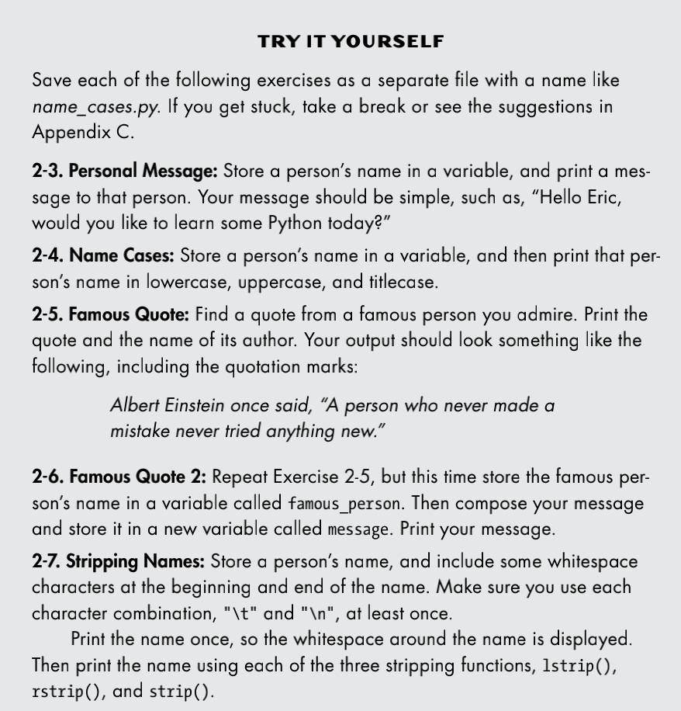
Types of Variables
Strings

Slide 13
Types of Variables
Numbers
Integers
Floats
Operations (+, -, *, /, **, %)
Convertion: the function str()

Slide 14
Types of Variables
Numbers
Try this code:
print(3 / 2)
print(10 ** 6)
print(2 + 3*4)
print((2 + 3)*4)
print(2 * 0.1)
print(2 ** 0.1)
print(0.2 + 0.1,3 * 0.1)
x,y,z=0,1.2,3
print(x,y,z)

Slide 15
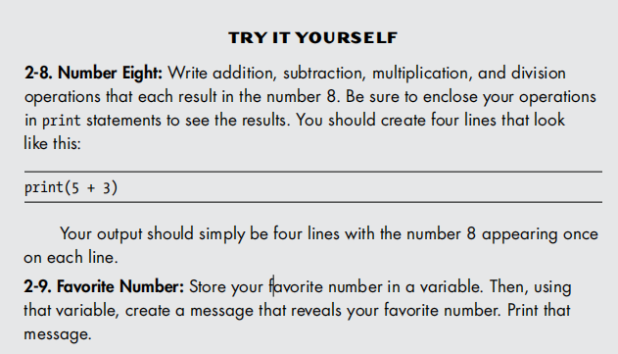
Types of Variables
Numbers
Try to do some simple operations with numbers using Python!

Slide 16
Comments
# Say hello to everyone.
#print("Hello Python !")
print("Hello Python !")
Output：
Hello Python !

Slide 17
Goodbye

